Slide 1
Employee Data Analysis using Excel
STUDENT NAME: L.SRIMATHI
REGISTER NO: 312218685
NM ID : 565792ED495106D839843E54065171D8
DEPARTMENT: B.COM ( GENERAL )
COLLEGE : VISHWAKSENAA ARTS & SCIENCE COLLEGE FOR WOMEN

Slide 2
PROJECT TITLE
Employee Performance Analysis using Excel

Slide 3


AGENDA
Problem Statement
Project Overview
End Users
Our Solution and Proposition
Dataset Description
Modelling Approach
Results and Discussion
Conclusion
3/21/2024 Annual Review

Slide 4

PROBLEM STATEMENT
✓This analysis is done by the company to know about the count of workers in the respective places and know how much are the total count of workers bases on their ratings in the company.
✓Improve employee performance analysis to enhance productivity, engagement, and alignment with company goals.
✓Optimize employee performance analysis.

Slide 5

PROJECT OVERVIEW
✓This project is analysis of number of workers in the company based on the ratings so that the company would be able to find out the total efficient workers of the company department wise in a company.
✓ The employee performance level analysis is useful for how employee are performed in a firm.
.

Slide 6

WHO ARE THE END USERS?
The end users of this data analysis will be the company and the company manager.
This analysis helps to find out the count of workers according to the rating of the employee in the company with number and accurate data.
By this they can analyze the workers rating pattern of the company.
The end user benefits are managers, Industry, employee, employer.

Slide 7

OUR SOLUTION AND ITS VALUE PROPOSITION
In the excel we want to use the conditional formatting for missing value highlight.
Filter is used for removing the missing value.
Formula is used for to find out the employee performance level.
Pivot table for summary the analysis.
The graph are used for analysis the employee data visualisation.

Slide 8
Dataset Description
The employee dataset is downloaded from edunet dashboard .
In the dataset there are 26 features from that only 9 features I have selected.
The 9 features are ;
1.Employee ID in a numerical value .
2. Employee First and Last name in a text format.
3. Employee type in a text format.
4. Performance level for employee performance.
5.In Gender feature used for male and female.
6. Employee rating in a numerical value.

Slide 9
THE "WOW" IN OUR SOLUTION
✓The 3D animated visualization result makes this a absolute blinder wow factor.
✓ performance level=IFS(Z8>=5," VERY HIGH" , Z8>=4,"HIGH",Z8>=3,"MED", TRUE,"LOW"
9

Slide 10
MODELLING
✓Data collection are downloaded from edunet foundation dashboard.
✓The employee dataset the features are identified.
✓ In a data cleaning missing values are identified and filter out the missing values.
✓ performance level calculation in required dataset.
✓ In the dataset selecting the required features.
✓ Click on Insert option and the click pivot table.
✓ when pivot table field is open and the select the feature to which analysis data.
✓Summarising the data.
✓Getting the results from the data after agreement.
1. Data visualization for graph
2. Recommended charts
10

Slide 11
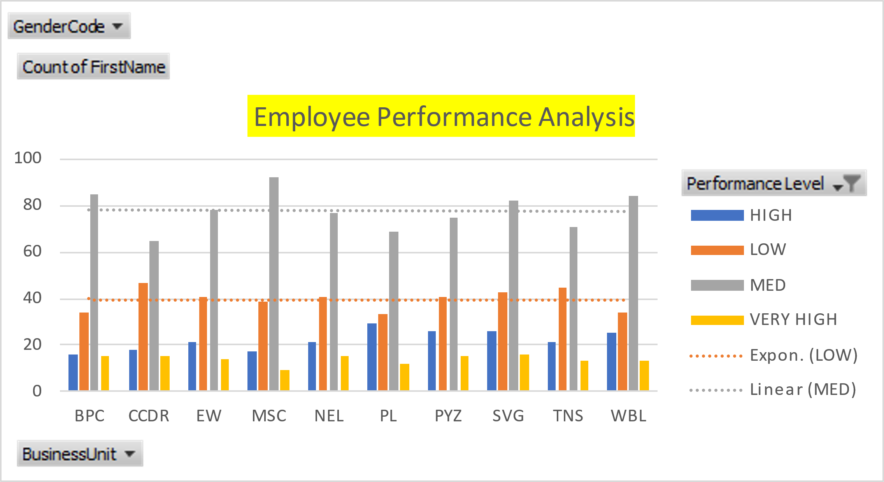
RESULTS:
11

Slide 13
Performance Rating

Slide 14
conclusion
By this data analysis we can be able to find the number of employees in the company based on their employee rating and the employee id so that the company will be able to find out the efficient worker for the company separately work and extract work from them. So that there will be an boost in the efficiency of the company. The most of employee are performed in medium rating and so to motivate the medium workers.

